Slide 1
R shortcuts that will save your life
David U. Garibay-Treviño, M.Sc.

Slide 2


Who am I?
My name is David Garibay-Treviño.
I am a Data Analyst and a Senior Associate at PADeCI (A team that promotes evidence-based decision-making to improve public policies).
I develop analytic models to inform health policies on
colorectal cancer, and
bladder cancer.

Slide 3
How I started using R?
I started using R during my master’s degree to develop statistical analyses.
My real R journey began in PADeCI, my actual work. Here I have
Implemented individual-level simulation models,
Developed cost-effectiveness analyses,
Generated interactive web apps using shiny,
And and much more.
I have become an R enthusiast.

Slide 4
A small tale

Slide 5

A small tale
I remember when I started to code in R

Slide 6
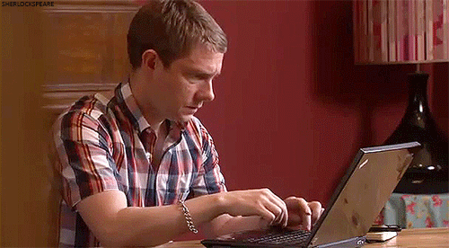
A small tale
I manually typed every part of the assignment operator (<-)

Slide 7
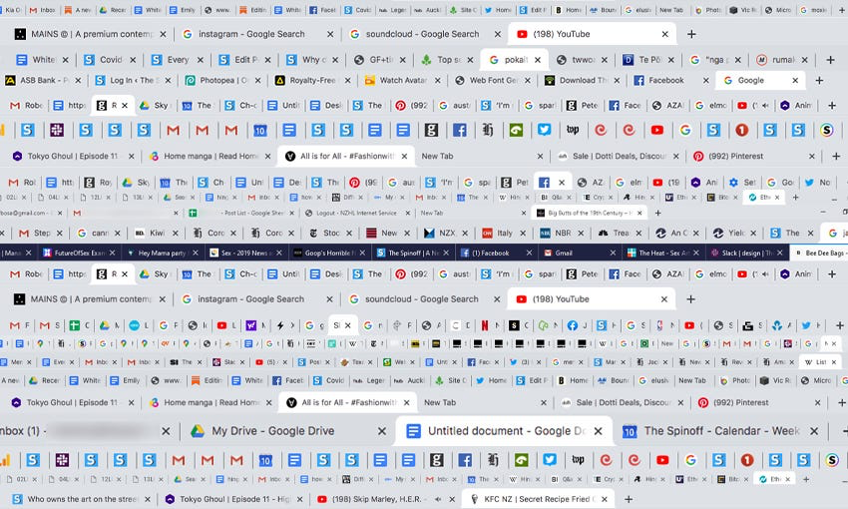
A small tale
The mouse was my main tool:
to open new scripts,
to move between tabs,
to close tabs

Slide 8
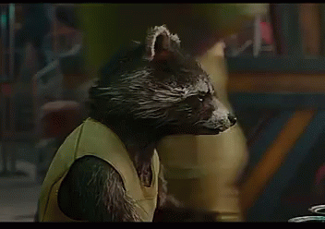
A small tale
While reading/saving files I had to be super careful writing their path and their names.
And still, I committed mistakes many times.

Slide 9
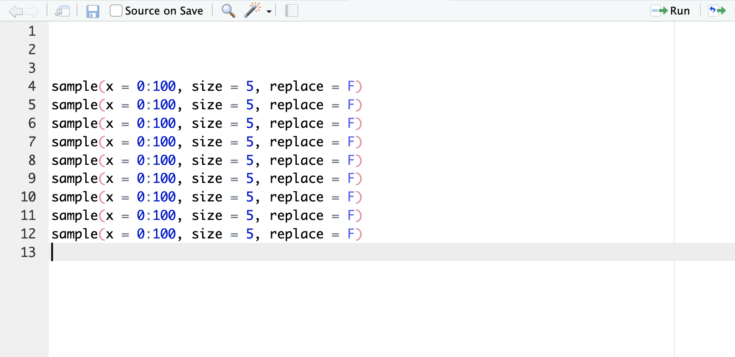
A small tale
And when commenting code

Slide 10
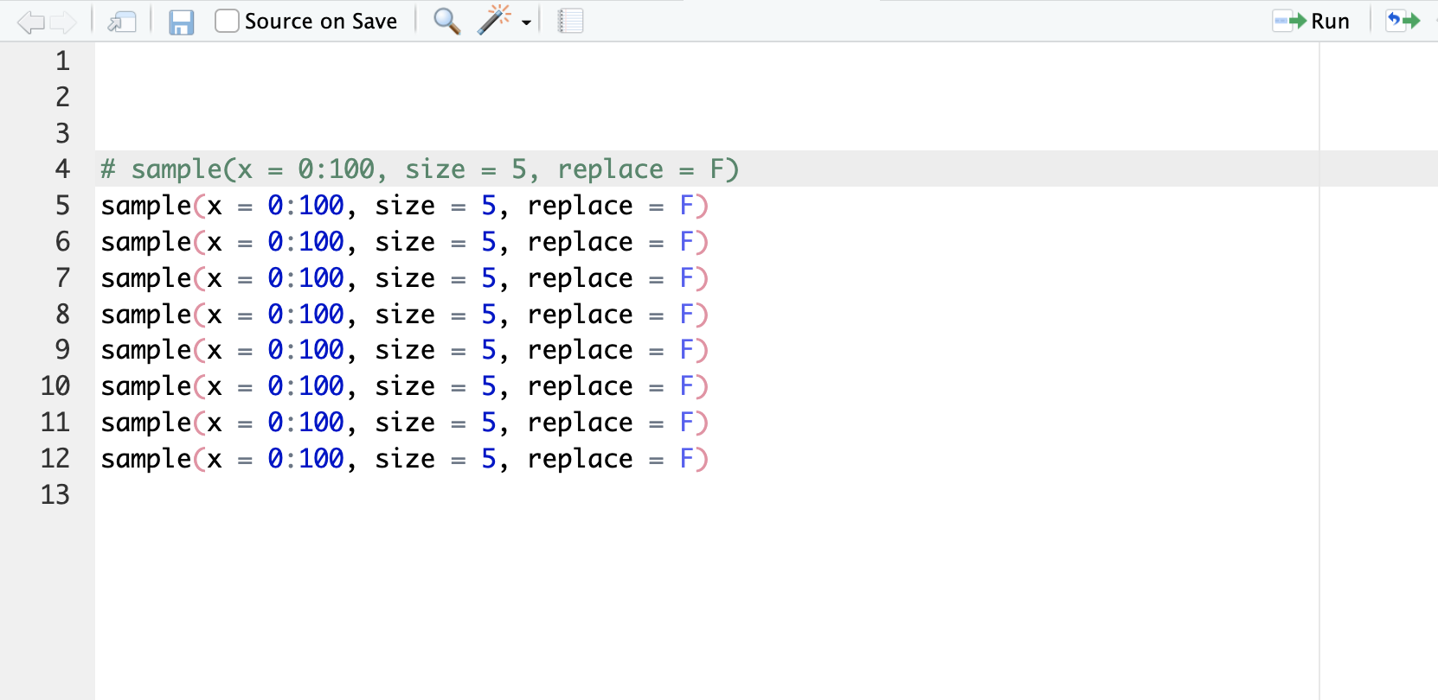
A small tale
I made it line by line

Slide 11
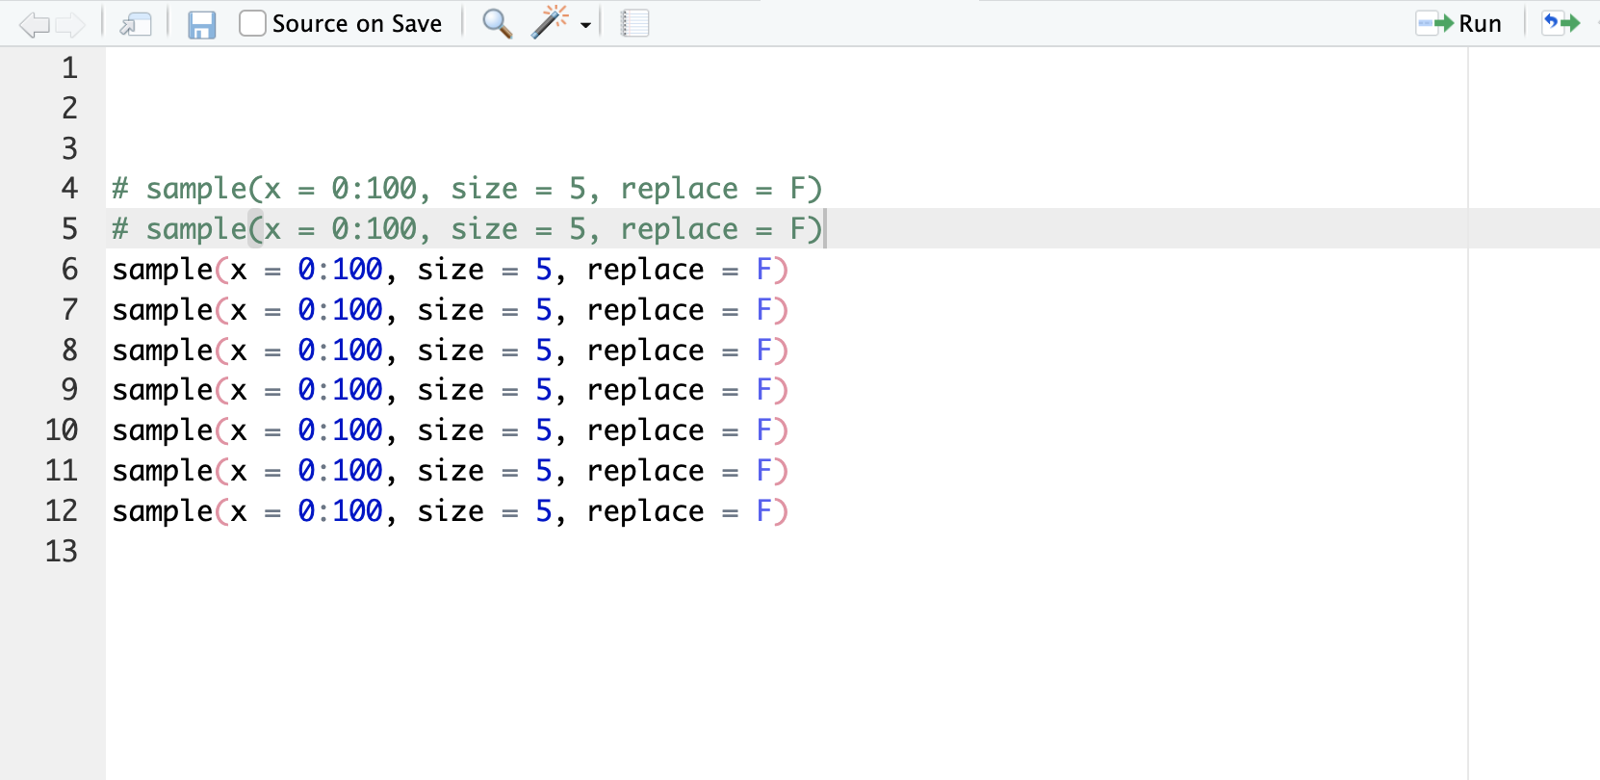
A small tale
Line by line

Slide 12
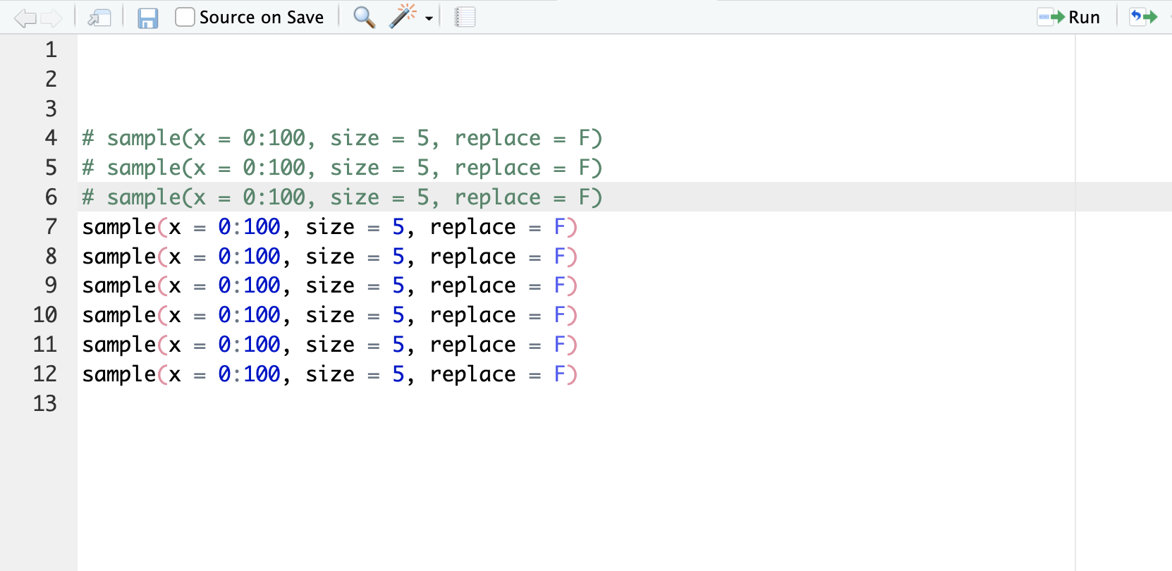
A small tale
by line

Slide 13
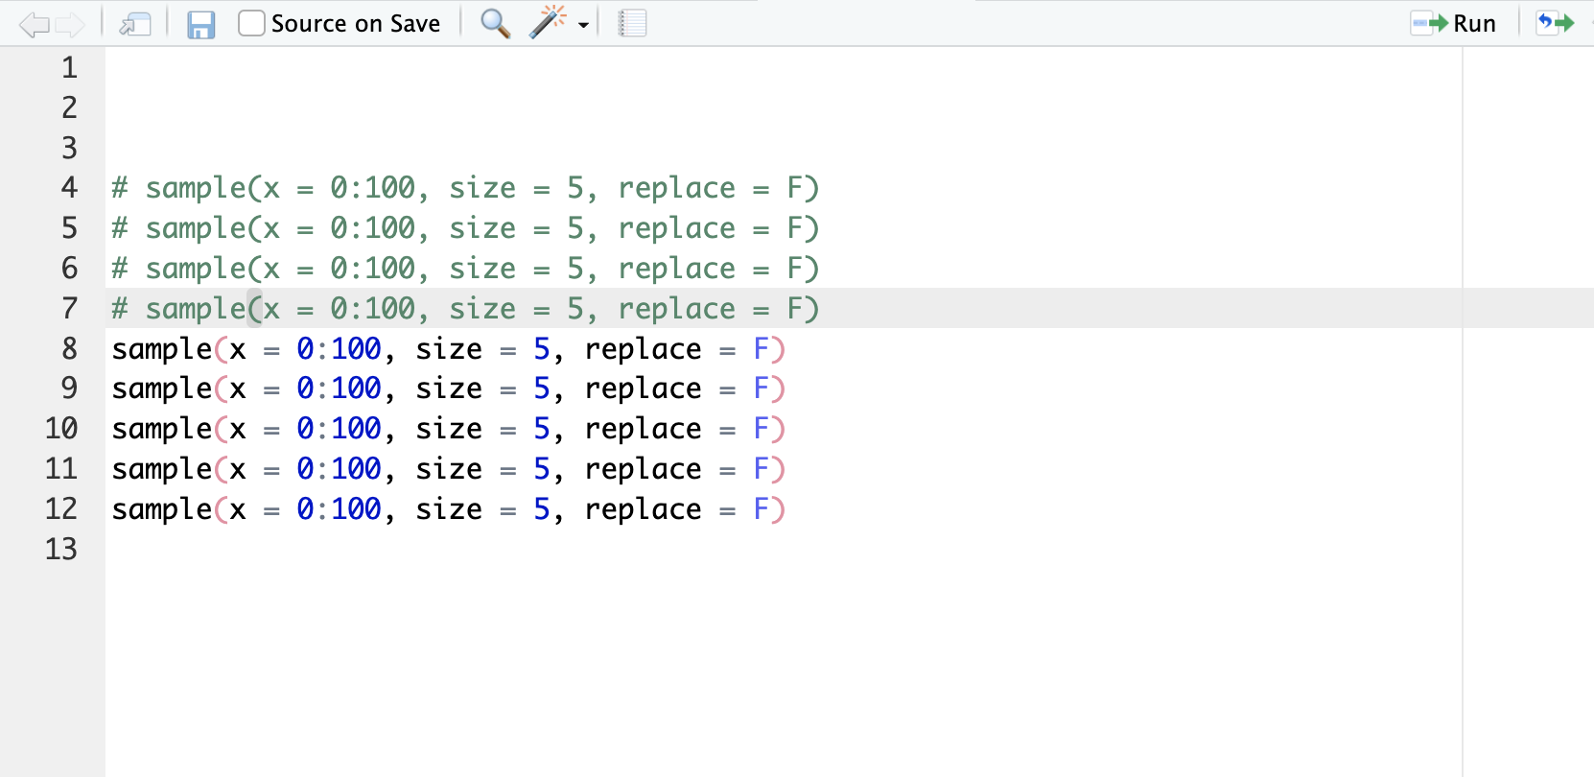
A small tale
By line

Slide 14
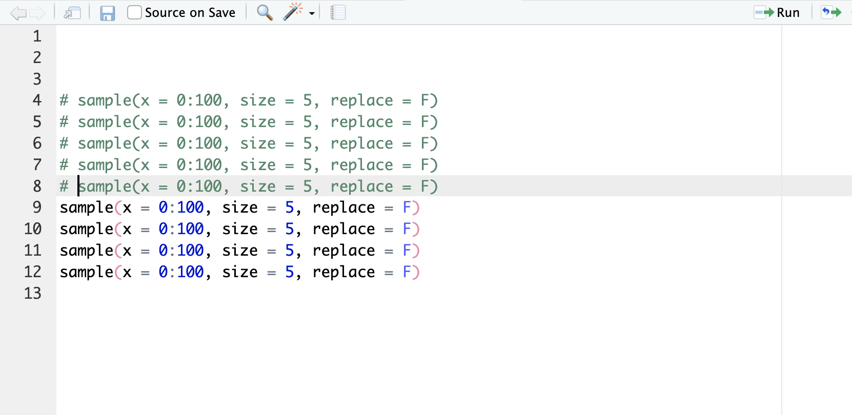
A small tale
By lineee

Slide 15
A small tale
Until one day

Slide 16
A small tale
I saw a colleague comment multiple lines

Slide 17
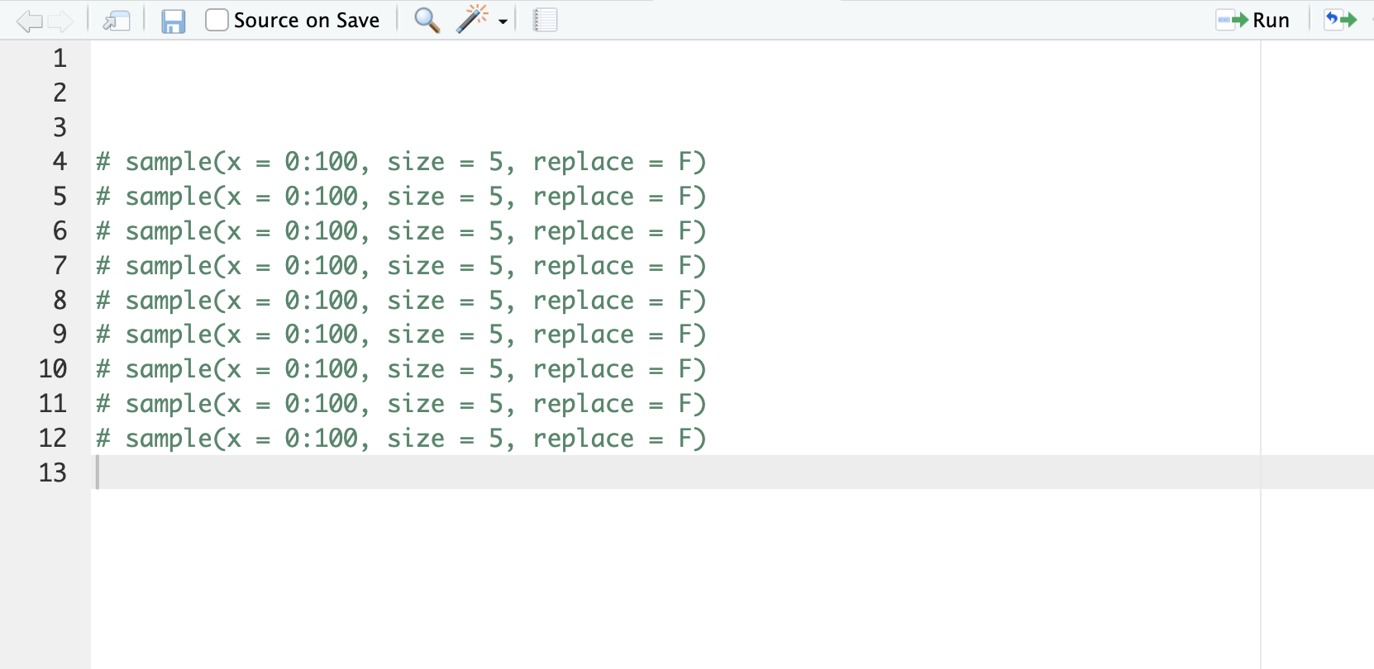
A small tale
I saw a colleague comment multiple lines
AT THE SAME TIME!!

Slide 18
A small tale
I was amazed!
I asked him how he did it, and it was really easy:
Select the text
Press Ctrl+C (Cmd+C in Mac)
And that was it!

Slide 19
A small tale
From that moment I began my journey to learn and use new shortcuts and commands in RStudio.

Slide 20

The goal of this workshop
I want to reduce your difficulties at a minimum while coding in R. Instead, I want you to focus on the main thing: making sure your code works.

Slide 21

Structure of the workshop
Enter to the article posted in the coding club’s website.
Download the workshop materials.
Follow the instructions written in the Workshop.R script.
I will illustrate how the shortcuts work
You will see which keys I’m pressing.
You can follow the script instructions in your computers.
Raise your hand if you have questions or comments.
Notes:
Jorge will be a moderator.

Slide 22

Access to the workshop materials
Access to the article posted in the coding club website.
You need to download and open the R project files. There are two alternatives:
Clone the GitHub repository or,
Download and decompress the .zip file I have uploaded in my google Drive.
Notes:
Github: https://github.com/du-gartre/R_shortcuts
Google drive: https://drive.google.com/file/d/1AwudVT6ixiS9iPmCF5_YeaFrrWuRSRfy/view?usp=sharing

Slide 23
CAUTION:
It’s a lot of information!
Focus on the shortcuts that you think will be more useful to your needs.
You will have to practice them to learn them by heart.

Slide 24

Let’s get down to business!
Open the RStudio project inside the folder you have downloaded.
shortcuts_workshop.Rproj

Slide 25

Article in coding club’s website RStudio shortcuts that will save your life
I have posted an article in the coding club’s website so you can review them at any time. Here’s the URL:
https://www.hertiecodingclub.com/learn/rstudio/r_shortcuts/

Slide 26

Many thanks, and good luck in your R journey!

